Slide 1

Working with Assistants Part 17: Functions

Slide 2
What’s Covered in This Session
Function Calling Overview
Simple Function Call Example
Streaming the Response
Going Further
About the National Weather Service API
Advanced Function Calling
Streaming the Response
A Word of Warning

Slide 3
Assistant Tools
File Search
Code Interpreter
Function
Notes:
https://platform.openai.com/docs/api-reference/assistants/createAssistant#assistants-createassistant-tools

Slide 4
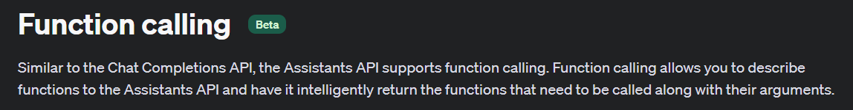
What is the temperature in Houston, TX?
Assistant API
National Weather Service API
Assistant API
The temperature in Houston, TX is 1000 degrees.
Notes:
https://platform.openai.com/docs/assistants/tools/function-calling/function-calling-beta

Slide 5
Demo: Simple “Function” Example
for tool in data.required_action.submit_tool_outputs.tool_calls:
if tool.function.name == "get_current_temperature":
tool_outputs.append({"tool_call_id": tool.id, "output": "57"})
elif tool.function.name == "get_rain_probability":
tool_outputs.append({"tool_call_id": tool.id, "output": "0.30"})
# Submit all tool_outputs at the same time
self.submit_tool_outputs(tool_outputs, run_id)

Slide 6



Notes:
https://www.youtube.com/channel/UC35ZpwldGw7ZJ5R-2sLijzw

Slide 7
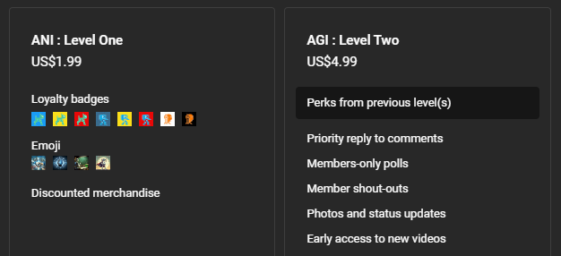

Membership has its privileges
Notes:
https://www.youtube.com/channel/UC35ZpwldGw7ZJ5R-2sLijzw/join

Slide 8
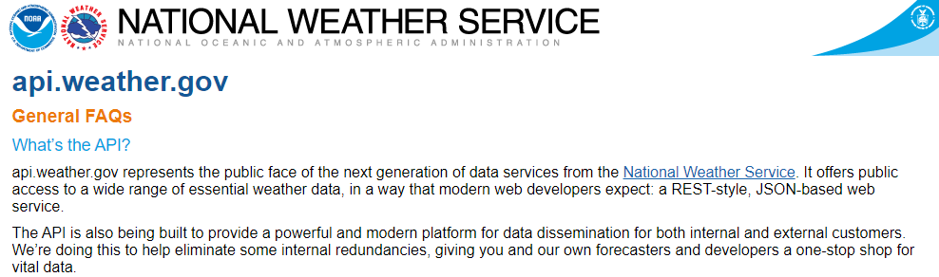
Demo: Advance Function Calling to a 3rd Party API

Slide 9
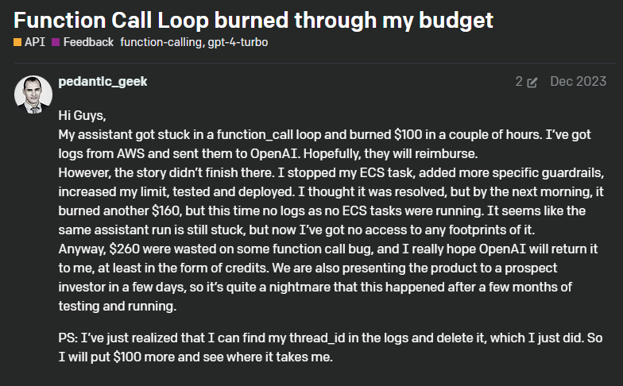
Warning: Functions to Expensive APIs
Notes:
https://community.openai.com/t/function-call-loop-burned-through-my-budget/550563

Slide 10


